Slide 1
Concurrency: Semaphores
Dr. Probir Roy
Some slides are modified from
* Dr. Shengquan Wang
Operating Systems: Three Easy Pieces, by Remzi H. Arpaci-Dusseau and Andrea C. Arpaci-Dusseau
Operating System Concepts, 8th edition, by Silberschatz, Galvin, Gagne, John Wiley & Sons, 2009
Notes:
1

Slide 2
Outline
Basics

Slide 3
Introduction
As we know now, one needs both locks and condition variables to solve a broad range of relevant and interesting concurrency problems.
One of the first people to realize this years ago was Edsger Dijkstra (though it is hard to know the exact history).
He invented semaphore as a single primitive for all things related to synchronization.
As you will see, one can use semaphores as both locks and condition variables.

Slide 4
Semaphores as resources
A semaphore is as an object with an integer value
Each unit represents a unit of resource, e.g.:
sem_t s;
sem_init(&s, 0, 6); // 6 units of resource.
sem_wait(&s): request for a unit of resource
If positive resource units are available, get one unit of resource;
Otherwise, wait until one unit of resource is available;
sem_post(&s): release one unit of resource
Wake a waiting thread too.
Notes:
4

Slide 5
Semaphores
int sem_wait(sem_t *s) {
- wait until value of semaphore s is greater than 0;
- decrement the value of semaphore s by 1;
}
int sem_post(sem_t *s) {
- increment the value of semaphore s by 1;
- if there are 1 or more threads waiting, wake 1;
}
Both are atomic operations!
Notes:
5

Slide 6
Implementation
Each semaphore will be associated with a queue for the sleeping threads.
The atomic operations can be implemented as done in mutex lock.

Slide 7
Semaphore and API
sem_t s;
sem_init(&s, pshared, init_value);
If pshared is nonzero, the semaphore can be shared between processes.
sem_destroy(&s);
sem_wait(&s);
Blocking wait operation
sem_trywait(&s);
Nonblocking wait operation
sem_post(&s);
signal operation
7
Notes:
7

Slide 8
Include files and libraries
.h file
#include <pthread.h>
#include <semaphore.h> /*for semaphore only*/
Compile and Linking
gcc foo.c -o foo -lpthread (for pthread only)
gcc foo.c -o foo -lpthread –lrt (for semaphore)
Semaphore are not defined in the POSIX.4a (pthread) specifications, but they are included in the POSIX.4 (realtime extension) specifications.
Notes:
8

Slide 9
Outline
Basics
Use semaphore

Slide 10
Use semaphore as a lock
sem_t s;
sem_init(&s, 0, 1);
……
sem_wait(&s);
// … critical section
sem_post(&s);
…

Slide 11
Use semaphore as condition variable: parent waiting for child
sem_t s;
void * child(void *arg) {
printf("child\n");
sem_post(&s);
return NULL;
}
int main(int argc, char *argv[]) {
sem_init(&s, 0, X); // what should X be?
printf("parent: begin\n");
pthread_t c;
pthread_create(c, NULL, child, NULL);
sem_wait(&s);
printf("parent: end\n");
return 0;
}
Expected output
parent: begin
child
parent: end
X=0

Slide 12
Outline
Basics
Use semaphore
Three classical questions

Slide 13
Bounded buffer problem (multiple producer/consumer)
Imagine one or more producer threads and one or more consumer threads.
Producers produce data items and wish to place them in a buffer.
Consumers grab data items out of the buffer consume the data in some way.
Example (a multi-threaded web server)
A producer puts HTTP requests into a work queue (i.e., the bounded buffer);
Consumer threads take requests out of this queue and process them.
Notes:
13

Slide 14
Design
Implementing a queue with an array
Produce
Enqueue
Consume
Dequeue
Notes:
14

Slide 15
Example
Notes:
15

Slide 16
Basic solution
void *producer(ItemType item) {
put(item);
}
void *consumer(ItemType& item) {
item = get();
}
ItemType buffer[MAX];
int fill = 0;
int use = 0;
void put(ItemType item) { buffer[fill] = item;
fill = (fill + 1)%MAX;
}
ItemType * get() { ItemType tmp = buffer[use];
use=(use+1)%MAX;
return tmp;
}
How to synchronize the access?
Notes:
16

Slide 17
First attempt
N buffers, each can hold one item.
Semaphore full initialized to the value 0.
Counting the number of full buffer slots.
Semaphore empty initialized to the value MAX.
Counting the number of empty buffer slots.
Notes:
17

Slide 18
First attempt (cont’d)
sem_t empty;
sem_t full;
void *producer(ItemType item) {
sem_wait(&empty);
put(item);
sem_post(&full);
}
……
……
void *consumer(ItemType& item) {
sem_wait(&full);
item = get();
sem_post(&empty);
}
int main() {
sem_init(&empty, 0, MAX);
sem_init(&full, 0, 0); }
Notes:
18

Slide 19
Problem
put(item)
put(item)
buffer[fill] = item;
fill = (fill + 1)%MAX;
buffer[fill] = item;
fill = (fill + 1)%MAX;
Interleaved operations when two producers both calling into put() at roughly the same time.

Slide 20
Adding mutual exclusion
N buffers, each can hold one item.
Semaphore full initialized to the value 0.
Counting the number of full buffer.
Semaphore empty initialized to the value N.
Counting the number of empty buffer.
Semaphore mutex initialized to the value 1.
Providing mutual exclusion for accesses to the buffer pool.
Notes:
20

Slide 21
Solution (synchronized)
sem_t empty;
sem_t full;
sem_t mutex;
void *producer(ItemType item) {
sem_wait(&empty);
sem_wait(&mutex);
put(item);
sem_post(&mutex);
sem_post(&full);
}
……
……
void *consumer(ItemType& item) {
sem_wait(&full);
sem_wait(&mutex);
item = get();
sem_post(&mutex);
sem_post(&empty);
}
int main() {
sem_init(&empty, 0, MAX);
sem_init(&full, 0, 0); sem_init(&mutex, 0, 1);
}
Notes:
21

Slide 22
Readers-writers problem
A data set is shared among a number of concurrent threads
Readers – only read the data set; they do not perform any updates.
Writers – can write.
Problem
Allow multiple readers to read at the same time.
Only one single writer can access the shared data at the same time.
R
W
R
R
R₁
R₂
W₁
R₃
R₄
R₅
W₂
W₃
R₆
0
2
4
6
8
10
12
14
16
Notes:
22

Slide 23
Two versions
First readers-writers problem
No reader will be kept waiting unless a writer has already obtained permission to write the shared data
Second readers-writers problem
Once a writer is ready, that writer performs its write ASAP
R
W
R
R
R₁
R₂
W₁
R₃
R₄
R₅
W₂
W₃
R₆
0
2
4
6
8
10
12
14
16
Notes:
23

Slide 24
Quiz: first readers-writers problem
// declare and init variables …
sem_t writelock;
void acquire_writelock( ) {
sem_wait(&writelock);
}
void release_writelock( ) {
sem_post(&writelock);
}
void acquire_readlock( ) {
}
void release_readlock( ) {
}
writer() {
acquire_writelock();
// writing …
release_writelock();
}
reader() {
acquire_readlock();
// reading …
release_readlock();
}
Notes:
24

Slide 25
Solution
Semaphore for first readers-writers problem
Data set.
Semaphore mutex initialized to 1.
Semaphore wrt initialized to 1.
Integer readcount initialized to 0.
R
W
R
R
R₁
R₂
W₁
R₃
R₄
R₅
W₂
W₃
R₆
0
2
4
6
8
10
12
14
16
Notes:
25

Slide 26
Solution (cont’d)
……
void acquire_readlock( ) {
sem_wait(&lock);
readers++;
if (readers == 1)
sem_wait(&writelock);
sem_post(&lock);
}
void release_readlock( ) {
sem_wait(&lock);
readers--;
if (readers == 0)
sem_post(&writelock);
sem_post(&lock);
}
sem_t writelock;
sem_t lock;
int readers;
readers = 0;
sem_init(&lock, 0, 1);
sem_init(&writelock, 0, 1);
void acquire_writelock( ) {
sem_wait(&writelock);
}
void release_writelock( ) {
sem_post(&writelock);
}
Notes:
26

Slide 27
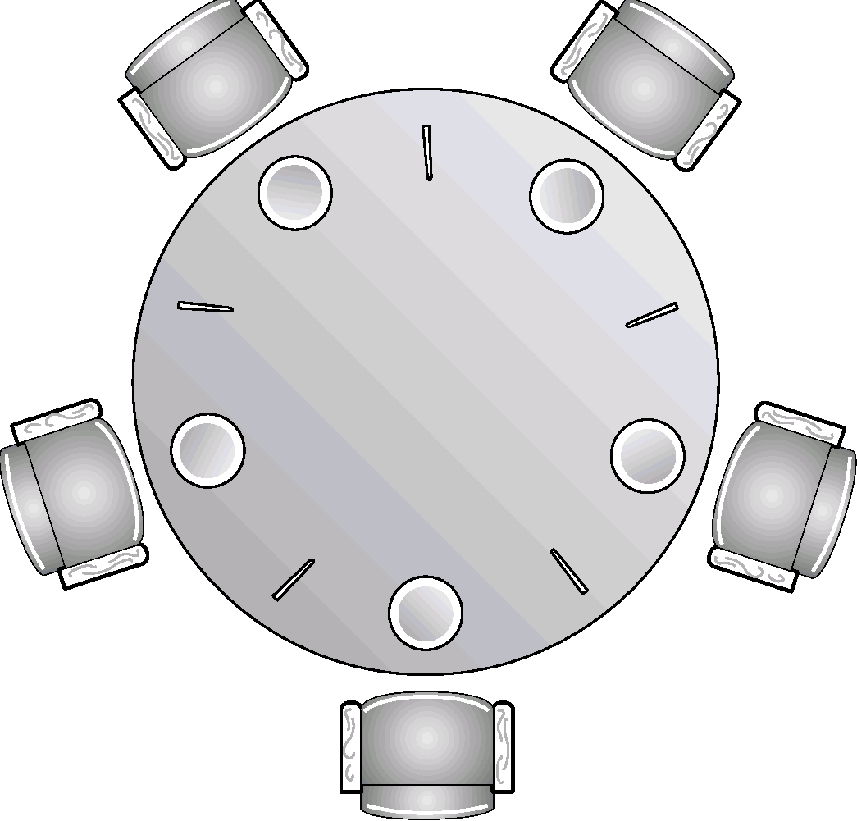
Dining-philosophers problem
Notes:
27

Slide 28
Dining-philosophers problem
Five silent philosophers sit at a round table with bowls of spaghetti. Forks are placed between each pair of adjacent philosophers.
Each philosopher must alternately think and eat. However, a philosopher can only eat spaghetti when they have both left and right forks. Each fork can be held by only one philosopher at a time and so a philosopher can use the fork only if it is not being used by another philosopher. After an individual philosopher finishes eating, they need to put down both forks so that the forks become available to others. A philosopher can only take the fork on their right or the one on their left as they become available and they cannot start eating before getting both forks.
Eating is not limited by the remaining amounts of spaghetti or stomach space; an infinite supply and an infinite demand are assumed.
The problem is how to design a discipline of behavior (a concurrent algorithm) such that no philosopher will starve; i.e., each can forever continue to alternate between eating and thinking, assuming that no philosopher can know when others may want to eat or think.

Slide 29
Dining-philosophers problem (cont’d)
sem_t chopstick[5];
sem_init(&chopstick, 0, 1);
Void *dinning_philosopher(int i) {
think();
sem_wait(&chopstick[i] );
sem_wait(&chopstick[(i + 1) % 5] );
eat();
sem_post(&chopstick[i] );
sem_post(&chopstick[(i + 1) % 5] );
think();
}
Notes:
29

Slide 30
How to implement semaphores?
Use our low-level synchronization primitives, locks and condition variables, to build semaphores.

Slide 31
Backup: Monitor

Slide 32
Problems with semaphores
Semaphores as the “GOTO” among the synchronization primitives.
Very powerful, but tricky to use.
Example of incorrect use of semaphore operations:
sem_post() … sem_wait()
sem_wait() … sem_wait()
Omitting of sem_wait(), or sem_post(), or both.
Need higher-abstraction primitives, for example:
Monitors
Notes:
32

Slide 33
Monitors (Hoare/Brinch Hansen, 1973)
An abstract data type
private shared variable
public procedures
To provide a safe and effective sharing of abstract data types among several processes.
Private shared variable accessible only through monitor’s public procedures.
Thread can enter monitor only by invoking monitor procedure.
Only one thread can be active in monitor.
Mutual exclusion.
monitor class monitor-name {
// private shared variable …
procedure P₁(…) { … … }
…
procedure P_{n}(…) { … … }
initialization_code ( ….) { … }
}
Notes:
33

Slide 34
Additional synchronization through conditions
condition variable x
wait(x):
Suspend execution of calling thread and enqueue it on a certain condition.
The monitor now is available for other threads.
signal(x):
Resume a thread enqueued on x.
If none is enqueued, do nothing.
monitor class monitor-name {
// private shared variable …
cond_t x, y;
procedure P₁(…) { … wait(x); … }
…
procedure P_{n}(…) { … signal(x); … }
initialization_code( ….) { … }
}
Notes:
34

